Slide 1


T1911
Graphs, building blocks of many algorithms.
A Quest Global Company
09/06/2025

Slide 2
Agenda
Topics Covered Today
Key Learnings / Concepts Understood:
Key Concepts with Definitions/ Code Snippet – Hands-on Practice
Challenges / Debugging Experience
Tasks/Assignments Completed
Additional Learning Resources / Notes
Q&A
Plan for Tomorrow

Slide 3
Topics Covered Today
Basics of Graphs
Graph Traversal
Shortest Path
Minimum Spanning Tree
Cycle Detection in Graphs

Slide 4
Key Learnings/Concepts Understood
Graphs consist of nodes (vertices) and connections (edges) used to model relationships.
Graphs can be directed or undirected, weighted or unweighted, cyclic or acyclic.
Depth-First Search (DFS) is a traversal technique that explores deep before backtracking.
Breadth-First Search (BFS) is a traversal method that explores level by level using a queue.
Dijkstra’s algorithm finds the shortest path in graphs with non-negative edge weights.
Bellman-Ford algorithm handles shortest paths with negative weights and detects negative cycles.
Minimum Spanning Tree (MST) connects all vertices with minimum total weight without cycles.
Prim’s and Kruskal’s algorithms are used to construct the Minimum Spanning Tree.
Cycle detection ensures graphs do not contain loops, critical in scheduling and validation.
Graphs are used in real-world applications like navigation, networking, and task scheduling.

Slide 5
Basics of Graphs
In C++, graphs are non-linear data structures that are used to represent the relationships between various objects. A graph is defined as a collection of vertices and edges.
Graph Basics
A graph consists of vertices (nodes) and edges (connections).
It can be directed/undirected, weighted/unweighted, and cyclic/acyclic.
Common representations: adjacency list (efficient) and adjacency matrix (dense graphs).
Types of Graphs
Directed Acyclic Graph (DAG): used in scheduling, compilers, etc.
Connected vs. Disconnected, Sparse vs. Dense, Cyclic vs. Acyclic graphs.
Represented using:
Adjacency Matrix (2D array, dense graphs)
Adjacency List (dictionary/list of lists, sparse graphs)
Applications:
Used in navigation, social networks, recommendation systems, and more.

Slide 6
Basics of Graphs
Graph Representation
Adjacency Matrix: In this representation, Matrix or two dimensional array is used to represent the graph.
Consider a graph of N vertices and the matrix M. If there is an edge present between verticies Vi and Vj then M[i][j] = 1 else M[i][j] = 0. Note that for an undirected graph if M[i][j] = 1 then for M[i][j] = 1. Here are some graphs shown by adjacency matrix.
Graph Representation
Adjacency Matrix for weighted graph: In the weighted graph, weights or distances are given along every edge.
Hence in an adjacency matrix representation any edge which is present between vertices Vi and Vj is denoted by its weight. Hence M[i][j] = Weight of edge.

Slide 7
Basics of Graphs
Adjacency List:
A list of lists where each list represent neighbors of a veretex.
It is space-efficient for sparse graphs.
Why Adjacency List?
Efficient for sparse graphs (few edges).
Space complexity: O(V + E).
Easily supports both directed and undirected graphs.
Graph using Adjacency Matrix in C++
A 2D matrix where matrix[i][j] = 1 if there's an edge from node i to j.
For weighted graphs, store the weight instead of 1.
Undirected graph → symmetric matrix.
Space complexity: O(V²).

Slide 8
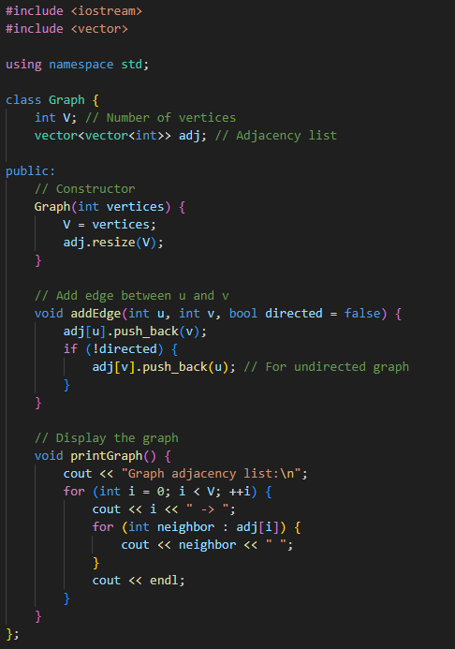
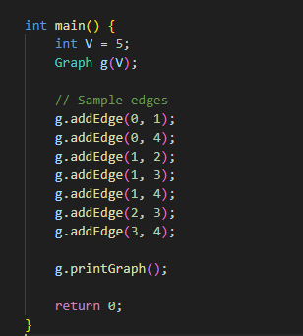
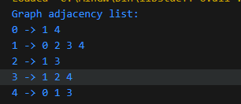
Basics of Graphs
Example(Adjacency List):
Output:-

Slide 9
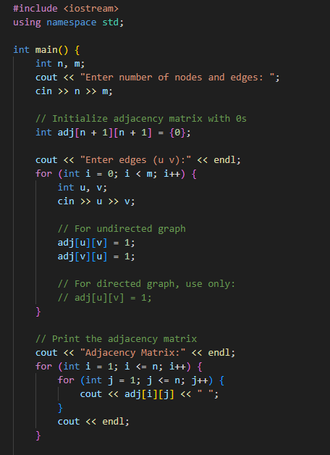
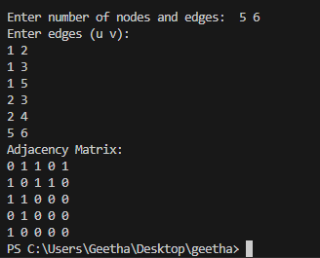
Basics of Graphs
Example(Adjacency Matrix):-
Output:-

Slide 10
Graph Traversal
DFS (Depth-First Search): Explores as far as possible down one branch before backtracking. Uses recursion or stack.
BFS (Breadth-First Search): Explores neighbors level by level using a queue.
Depth-First Search (DFS):
Goes as deep as possible before backtracking.
Implemented using recursion or a stack.
Good for detecting cycles, connected components, and topological sorting.
Breadth-First Search (BFS):
Visits all neighbors level by level.
Uses a queue.
Used to find shortest path in unweighted graphs.

Slide 11
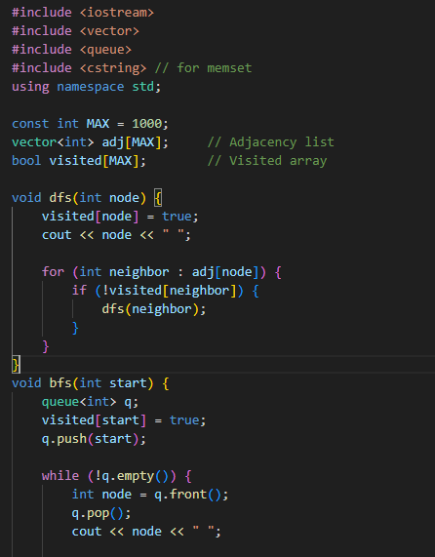
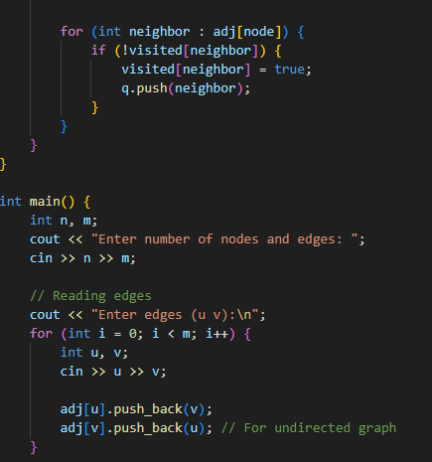
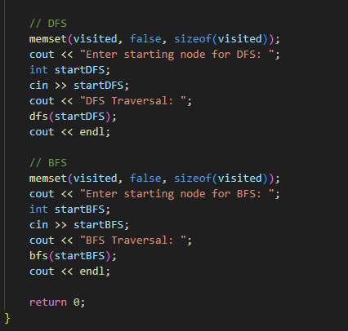
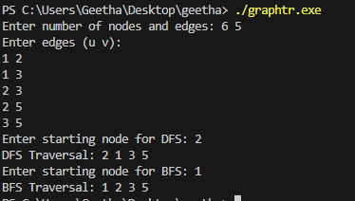
Graph Traversal
Example:-
Output:-

Slide 12
Shortest Path
Shortest Path
Goal:
Find the minimum distance from a source node to other nodes.
Algorithms:
Dijkstra's Algorithm:
Works with non-negative weights.
Uses a min-heap (priority queue).
Time complexity: O((V + E) log V)
Common in routing (GPS, networks).
Bellman-Ford Algorithm:
Handles negative weights (but not negative cycles).
Slower than Dijkstra: O(VE).
Floyd-Warshall Algorithm:
Finds shortest paths between all pairs of vertices.
Time: O(V³)

Slide 13
Minimum Spanning Tree (MST)
Minimum Spanning Tree (MST)
Definition:
A spanning tree connects all nodes in a graph with the minimum total edge weight, without cycles.
Real-world use:
Network design (e.g., laying cables, pipelines with minimal cost).
Algorithms:
Kruskal's Algorithm:
Sort all edges by weight.
Add edges one by one if they don't form a cycle (using Union-Find).
Prim's Algorithm:
Start from a node.
Always pick the minimum weight edge connecting a visited and unvisited node.
Uses a priority queue.

Slide 14
Cycle Detection in Graphs
Cycle Detection in Graphs
Goal:
To check if a graph contains a loop.
Why it matters:
Important for avoiding infinite processes.
Useful in:
Dependency resolution (e.g., task schedulers)
Validating trees
Techniques:
For Undirected Graph:
Use DFS.
If a neighbor is visited and not the parent, a cycle exists.
For Directed Graph:
Use DFS with a recursion stack.
If a node is visited and still in the recursion stack, a cycle is present.
Using Union-Find (Disjoint Set):
Often used in Kruskal’s algorithm for efficient cycle detection.

Slide 15
Challenges / Debugging Experience
Forgetting to mark nodes as visited during DFS or BFS can lead to infinite loops or revisiting the same node multiple times.
Accessing neighbors from uninitialized adjacency lists can cause segmentation faults always initialize or resize adj[] properly.
Incorrectly assuming bidirectionality in directed graphs — always be sure whether edges are one-way or two-way when building the graph.
In Dijkstra’s algorithm, pushing updated distances without checking visited status can cause the algorithm to run longer or return wrong paths.
Kruskal's algorithm requires sorting all edges first, and forgetting to use Union-Find for cycle detection breaks the MST logic.
Cycle detection in directed graphs requires tracking the recursion stack — missing this can lead to incorrect cycle detection.
Using BFS for shortest path in weighted graphs is incorrect — Dijkstra or Bellman-Ford should be used instead.

Slide 16
Additional Learning Resources / Notes
CPP Reference — Comprehensive and official C++ documentation.
cplusplus.com — Beginner-friendly tutorials and examples for STL algorithms.
Containers in C++ STL | GeeksforGeeks
YouTube tutorials — Search for C++ STL algorithms and sorting tutorials.
Practice coding problems on platforms like LeetCode, Codechef.
Experiment with custom comparators to learn more about flexible sorting.

Slide 17
Q&A
Q1: What is a graph in computer science? A: A graph is a data structure consisting of vertices (nodes) connected by edges, which can be directed or undirected, weighted or unweighted.
Q2: What is the difference between BFS and DFS in graph traversal? A: BFS explores nodes level-by-level using a queue, while DFS explores as deep as possible along each branch using recursion or a stack.
Q3: How is a graph commonly represented in memory? A: Using adjacency lists (efficient for sparse graphs) or adjacency matrices (simple but uses more memory).
Q4: What is the purpose of Dijkstra’s algorithm? A: To find the shortest path from a single source node to all other nodes in a weighted graph with non-negative edge weights.
Q5: What does a Minimum Spanning Tree (MST) represent? A: It is a subset of edges connecting all vertices with the minimum possible total edge weight, without forming any cycles.

Slide 18
Plan for Tomorrow
Associative Containers

Slide 19
Overall Overview
A graph is a collection of vertices (nodes) connected by edges, which can be directed or undirected and weighted or unweighted.
Graph traversal techniques like Depth-First Search (DFS) and Breadth-First Search (BFS) help explore all nodes systematically.
DFS explores as far as possible along a branch before backtracking, using recursion or a stack.
BFS visits nodes level-by-level using a queue, often finding the shortest path in unweighted graphs.
The shortest path problem finds the minimum distance between two nodes, commonly solved by Dijkstra’s algorithm for graphs with non-negative weights.
Minimum Spanning Tree (MST) is a subset of edges connecting all vertices with the smallest total weight, without forming cycles.
Kruskal’s and Prim’s algorithms are popular methods to find MST efficiently.
Cycle detection identifies if a graph contains loops, crucial for ensuring correctness in networks and avoiding infinite loops.
In undirected graphs, cycle detection is done with DFS and parent checks; in directed graphs, it uses recursion stacks or advanced algorithms.
Mastering these graph concepts is fundamental for solving problems in networking, routing, scheduling, and many real-world applications.

Slide 20


Thank You

